Slide 1
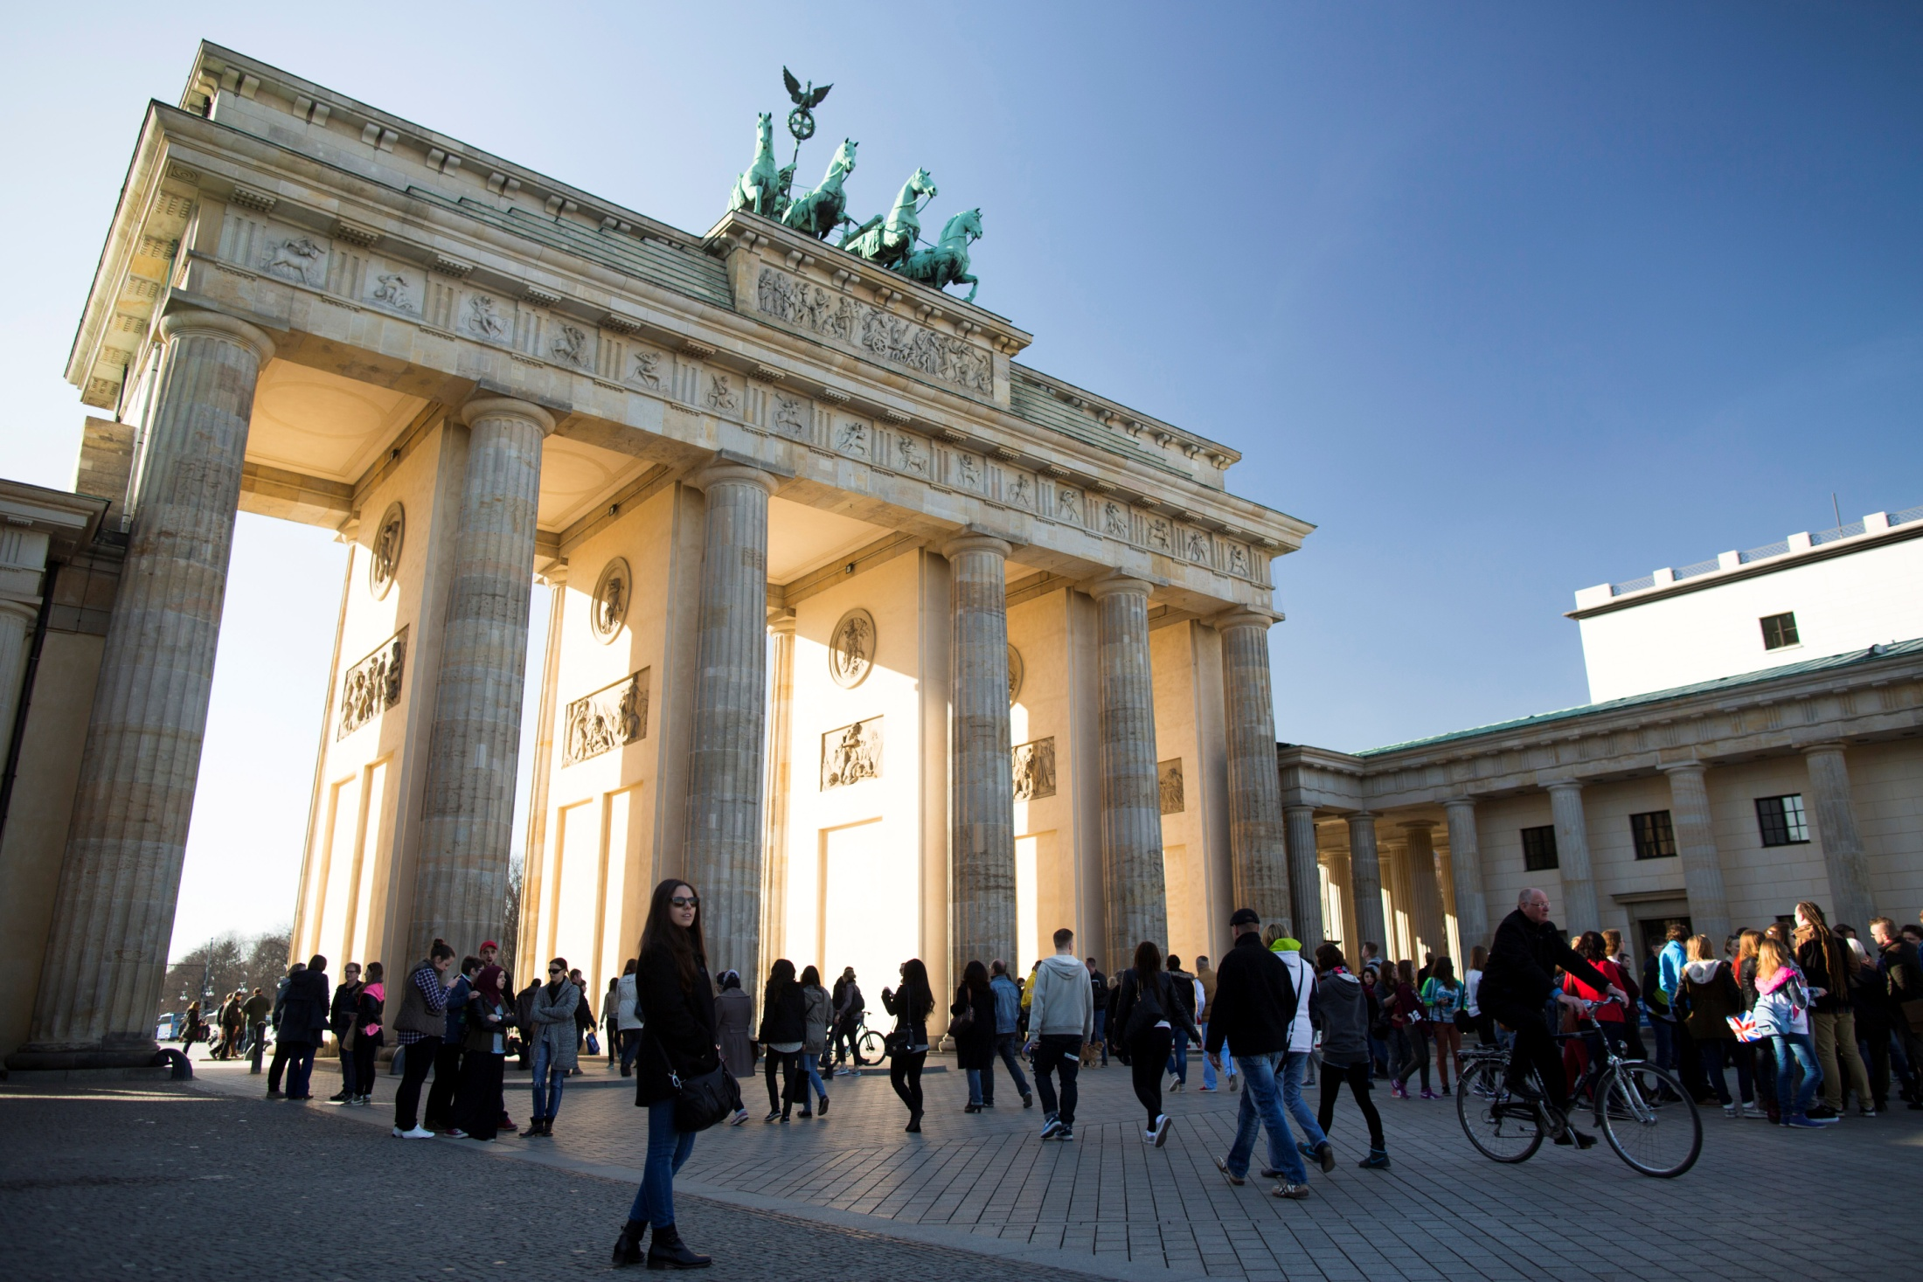



Welcome to Berlin
Application to host “EUROCORR 2022
– the annual event of the
European Federation of Corrosion”
04.-08.09.2022 in Berlin, Germany

Slide 2
CONTENTS
INTRODUCTION OF THE ASSOCIATIONS
CONFERENCE DETAILS
ACCOMMODATION
TRAVEL AND TRANSPORTATION
BERLIN: THE “WOW” FACTORS…

Slide 3
1. INTRODUCTION OF THE ASSOCIATIONS
About DECHEMA
About GfKORR

Slide 4
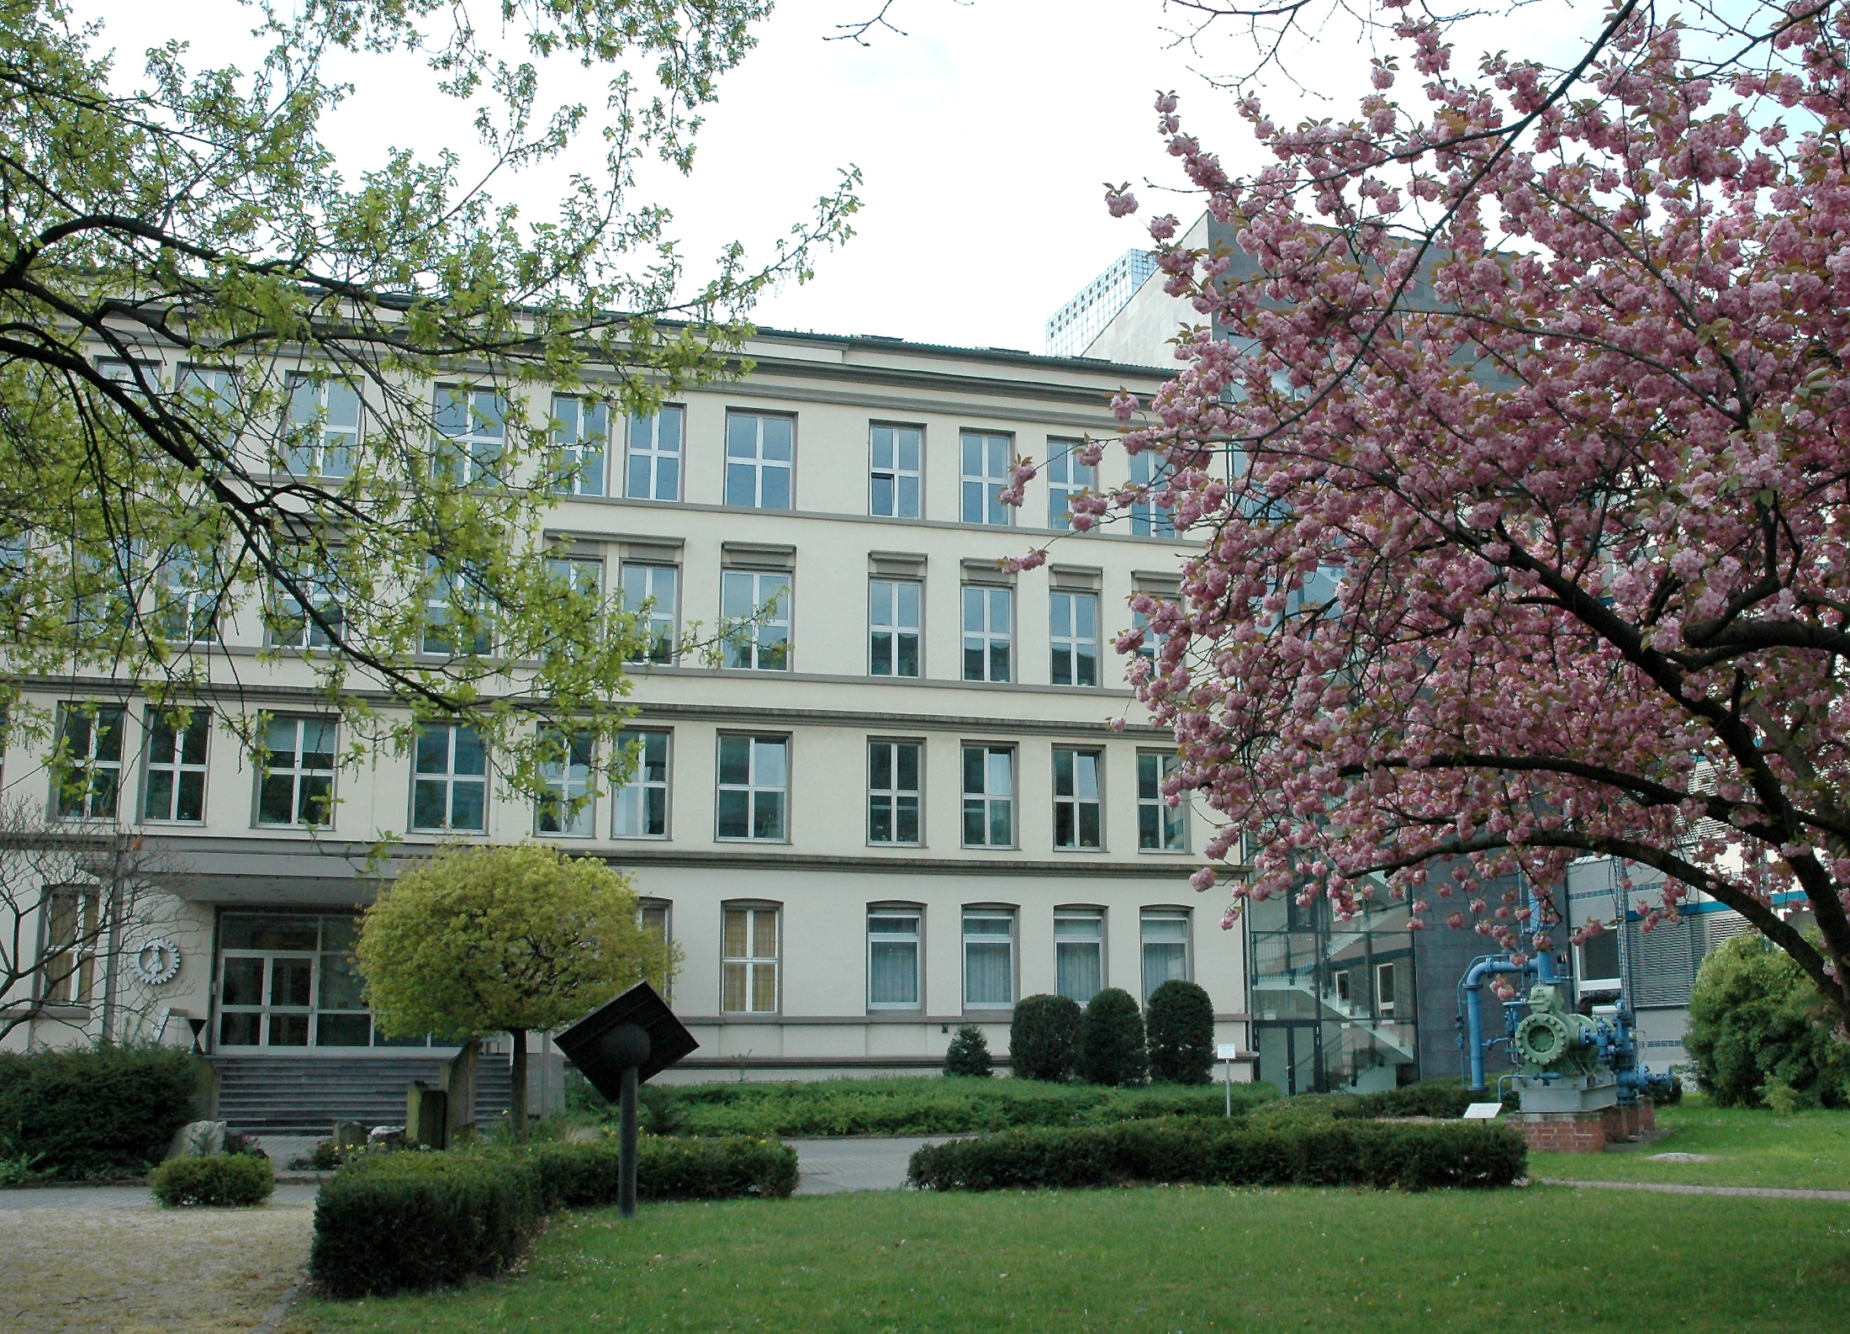
About DECHEMA (founded in 1926)
DECHEMA and GfKORR are non-profit
scientific and technological societies:
With more than 6,500 members – among these more than 700 companies and institutions
Organiser of ACHEMA
• About 100 conferences, colloquia and
continuing education programs with more
than 10,000 participants annually
• Thematic work in around 100 committees
• Post graduate studies for young researchers

Slide 5
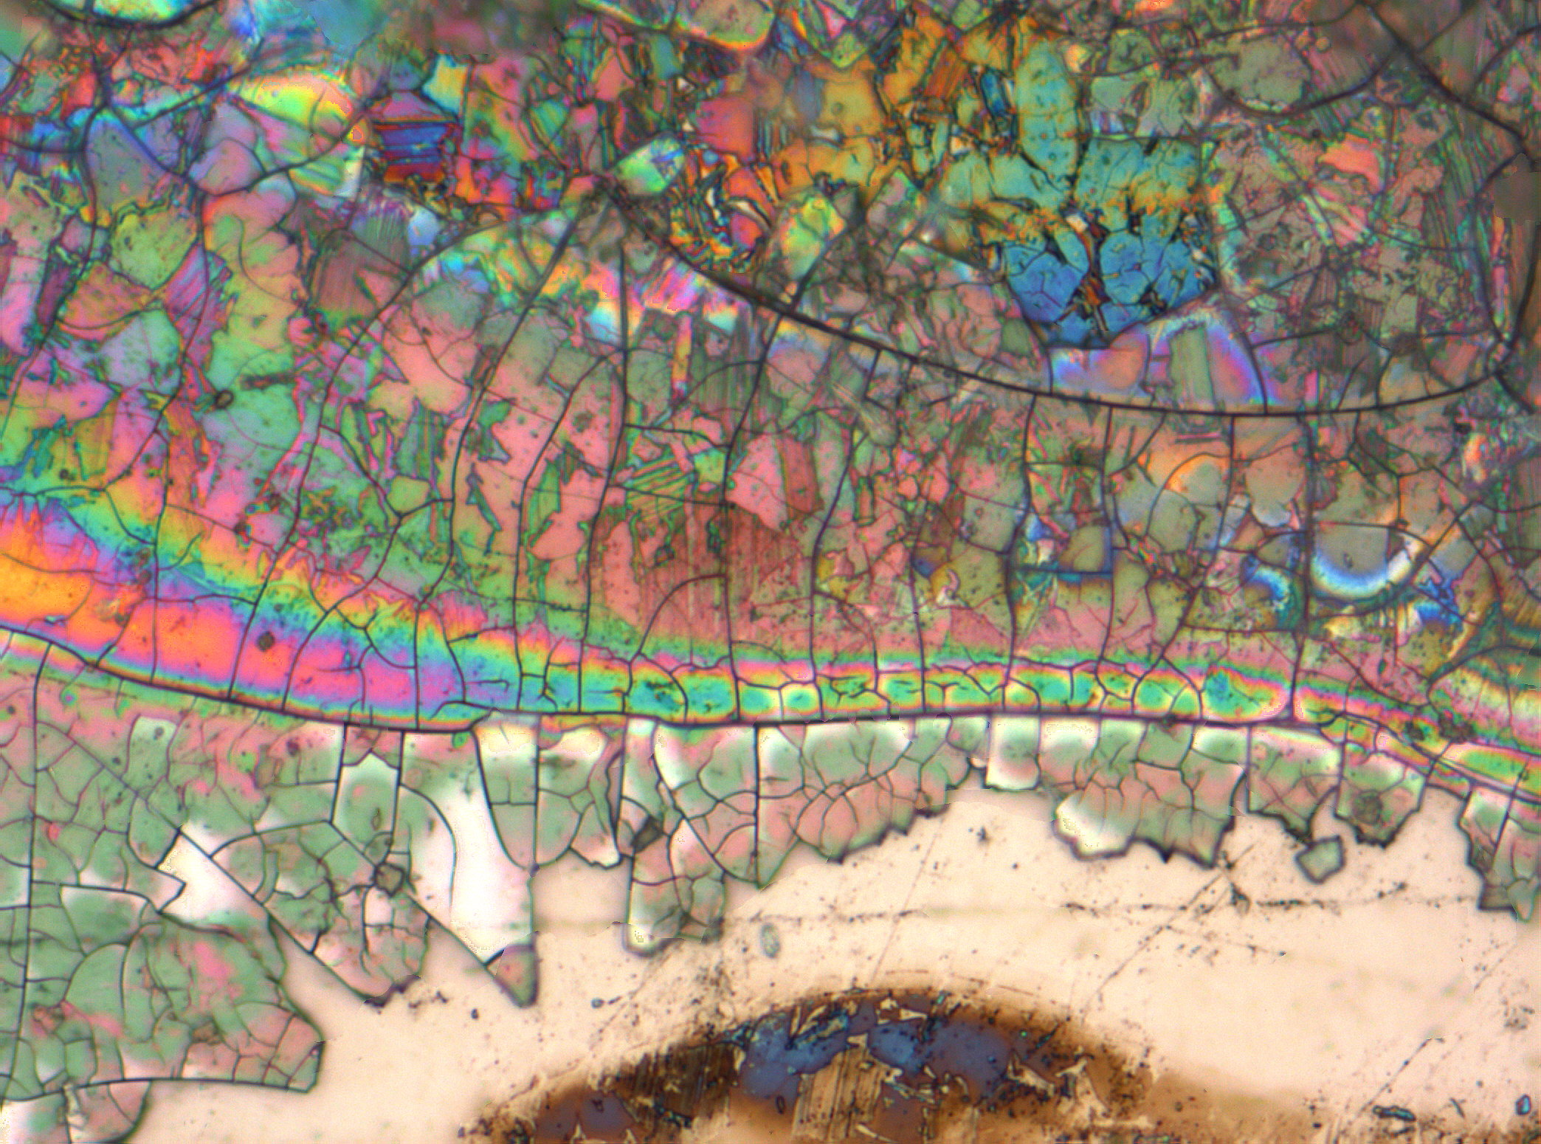
About GfKORR (founded in 1995)
GfKORR - Society for Corrosion Protection is
a federation of corrosion experts from
industry and academia working in all fields
of corrosion science with the aim of avoiding
corrosion and its negative consequences.
The work of GfKORR is devoted to the support
of corrosion research and the dissemination of
knowledge of corrosion protection in all
relevant fields.

Slide 6
2. CONFERENCE DETAILS
The Venue – Estrel Hotel and Convention Center
Capacities – Meeting Facilities
Floorplans, Conference Area
Conference Dinner
Details of the planned EUROCORR
Calculation
Scientific Topics

Slide 7
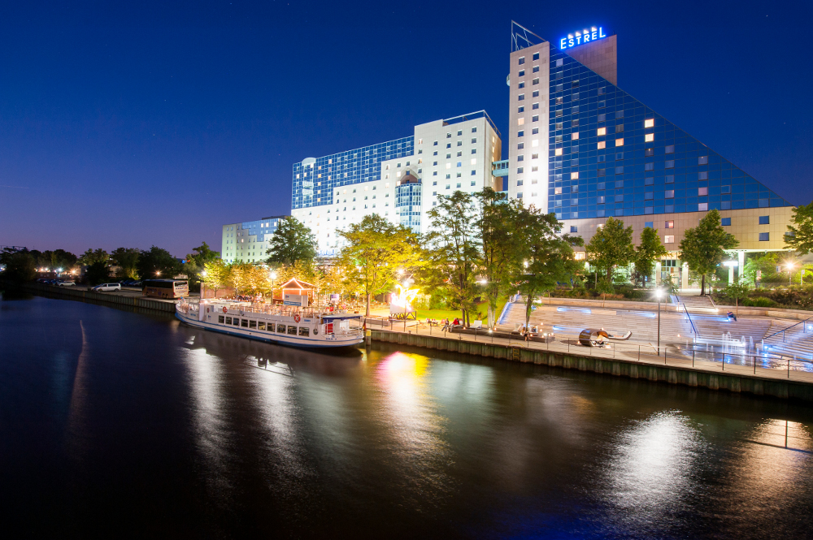
located within easy reach of the city centre
more hotels in direct proximity
metro and bus station in front of the entrance
15 minutes from airport Schönefeld
30 minutes from airport Tegel
state-of-the-art congress equipment
meeting facilities for more than 10,000 attendees
Estrel Hotel and Convention Center

Slide 8
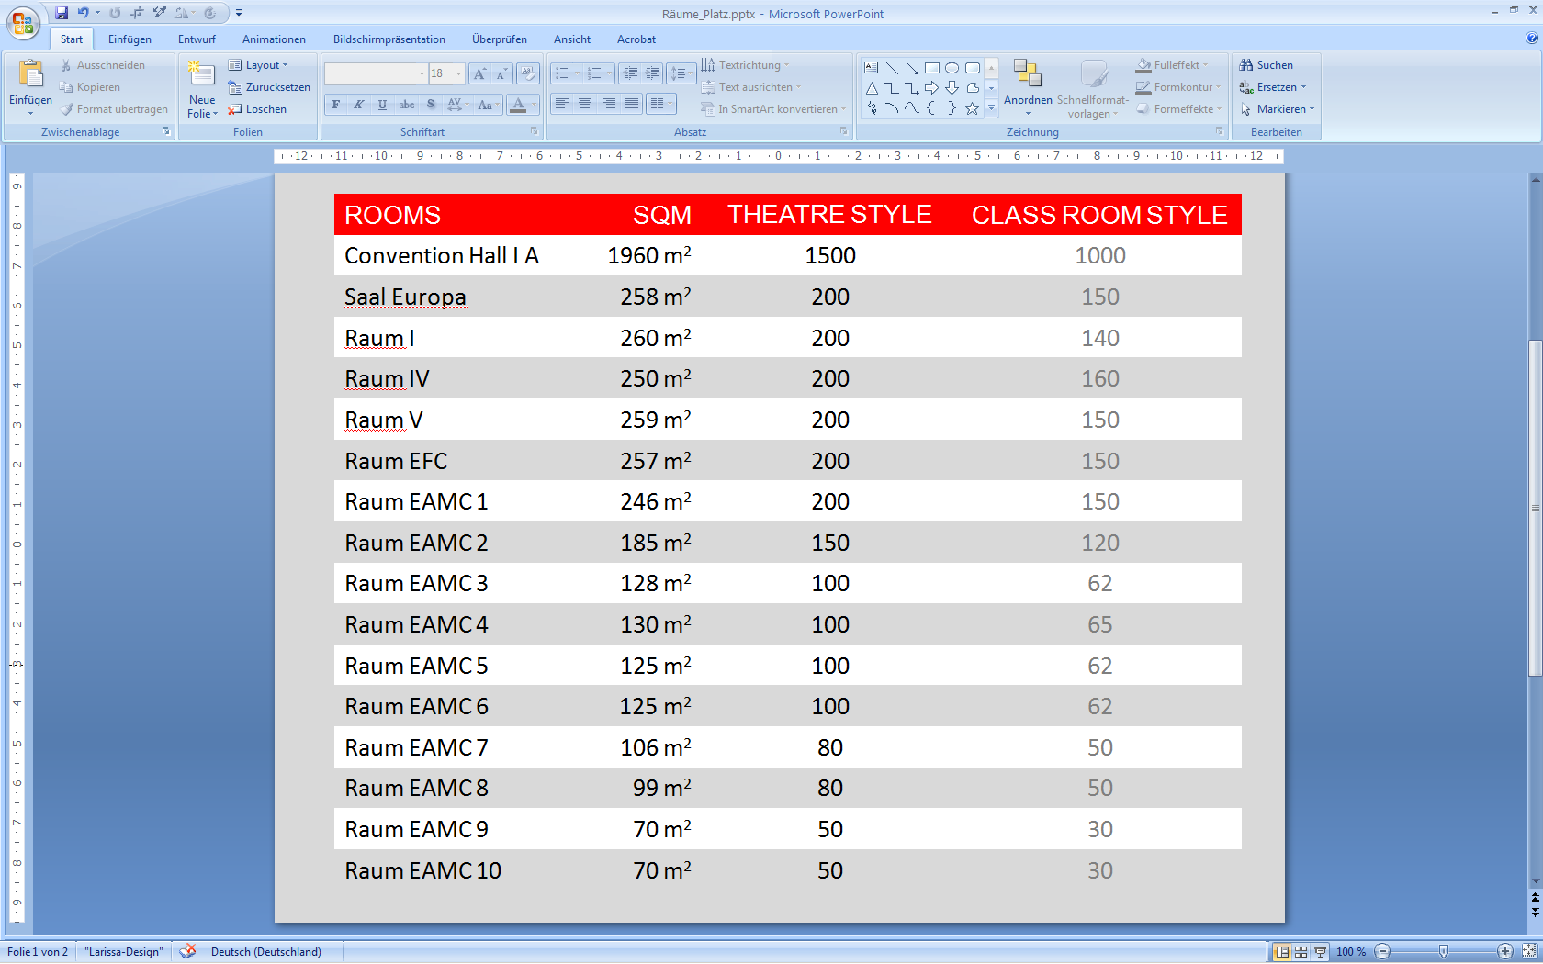
Capacities – Meeting Facilities

Slide 9
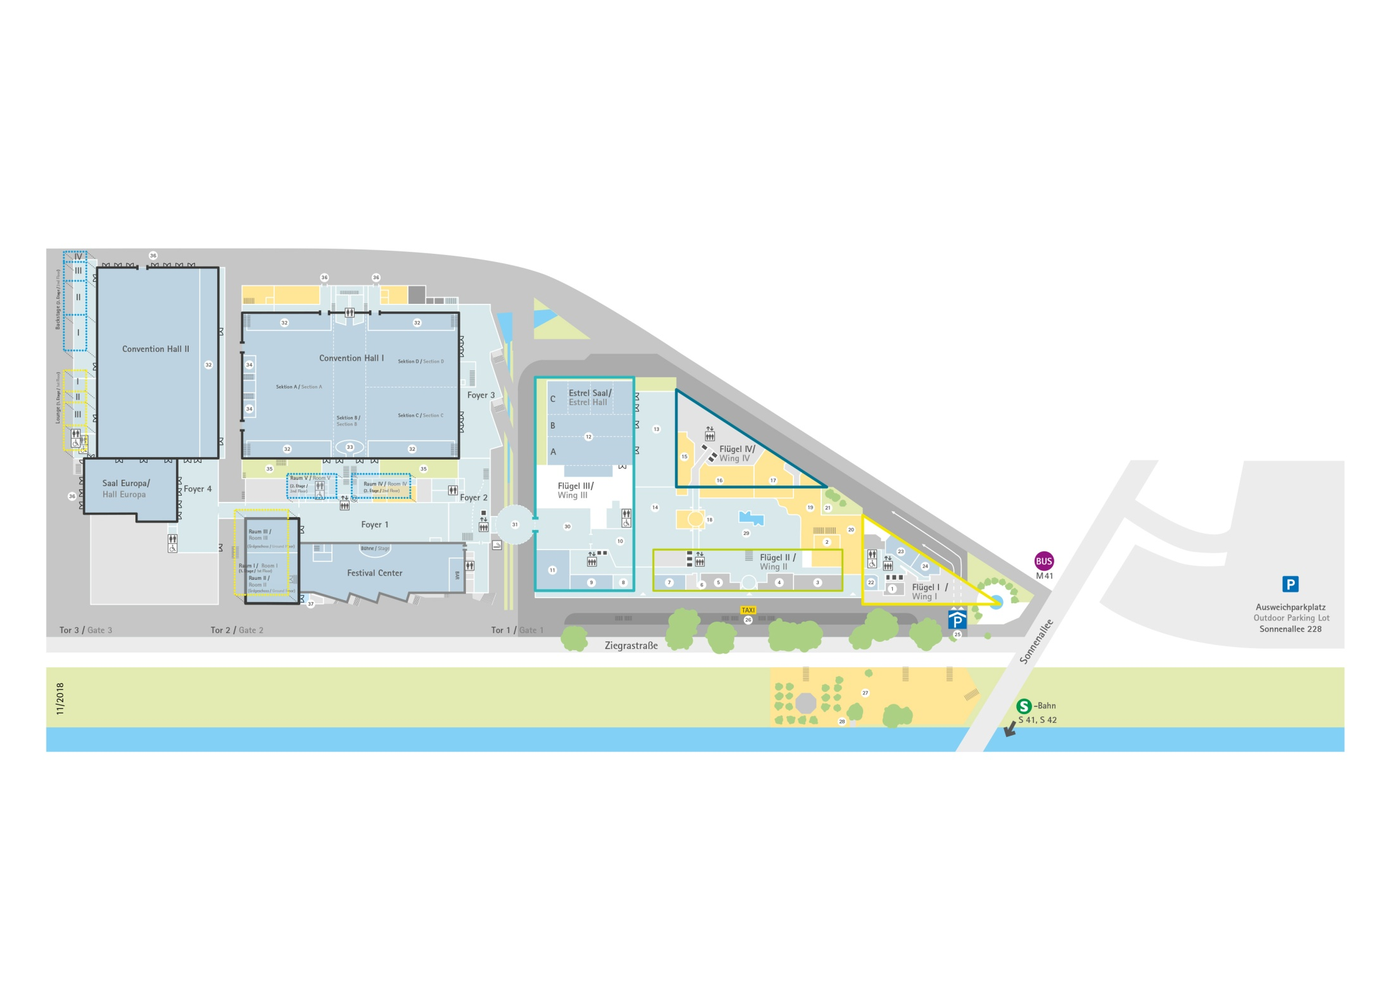
Conference Area
Hotel Area
Lunch
Coffee breaks
Exhibition
Poster area
4600 m²
Convention Hall I A
Europa
Raum
I, IV, V
Meeting
rooms
EAMC 1-10
Level 0-2
EFC
Conference Area
Lecture Halls, Exhibition, Poster Area, Welcome and
Poster Party, Coffee and Lunch breaks
Hotel Area
Meeting rooms for Working Party Business Meetings
Floorplans

Slide 10
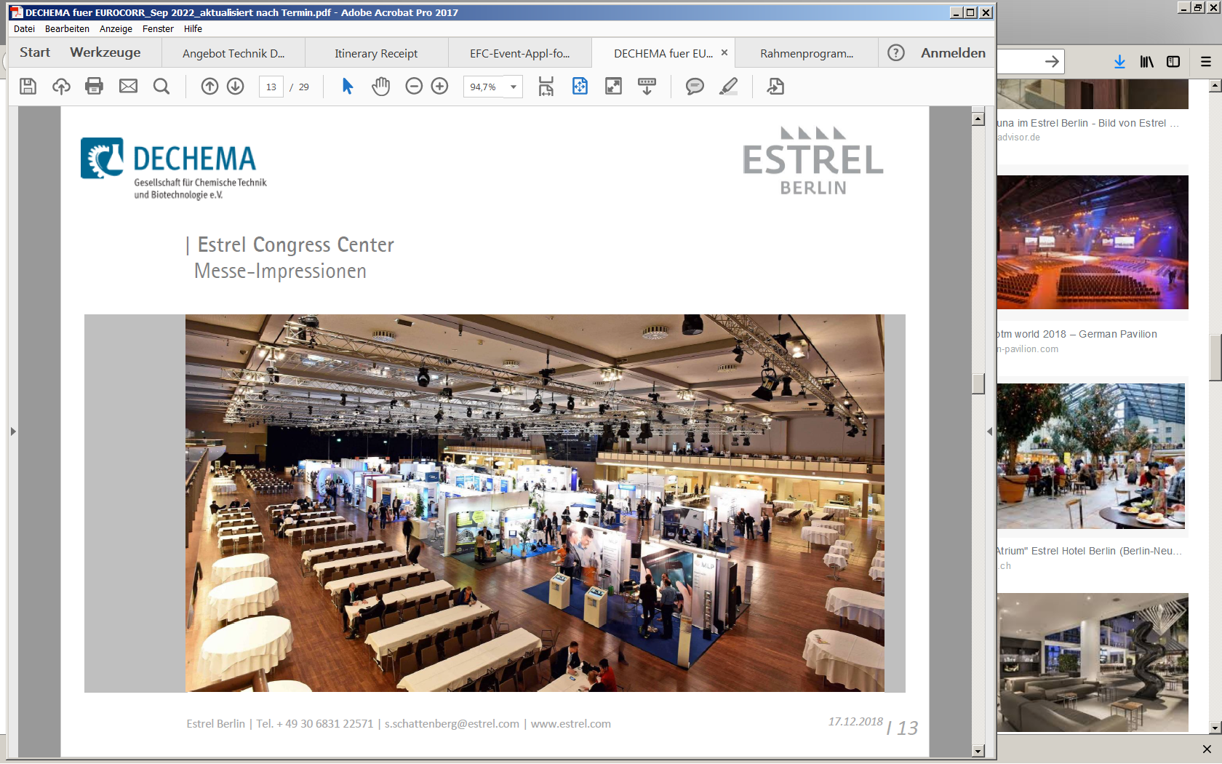
Conference Area
Lecture Halls, Plenary Lectures, Exhibition, Poster Area,
Welcome and Poster Party, Coffee and Lunch breaks

Slide 11
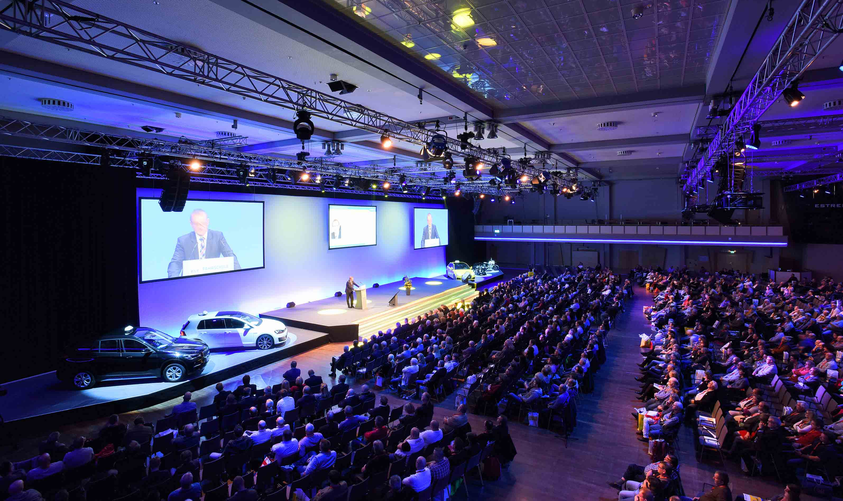
Conference Area
Lecture Halls, Plenary Lectures, Exhibition, Poster Area,
Welcome and Poster Party, Coffee and Lunch breaks

Slide 12
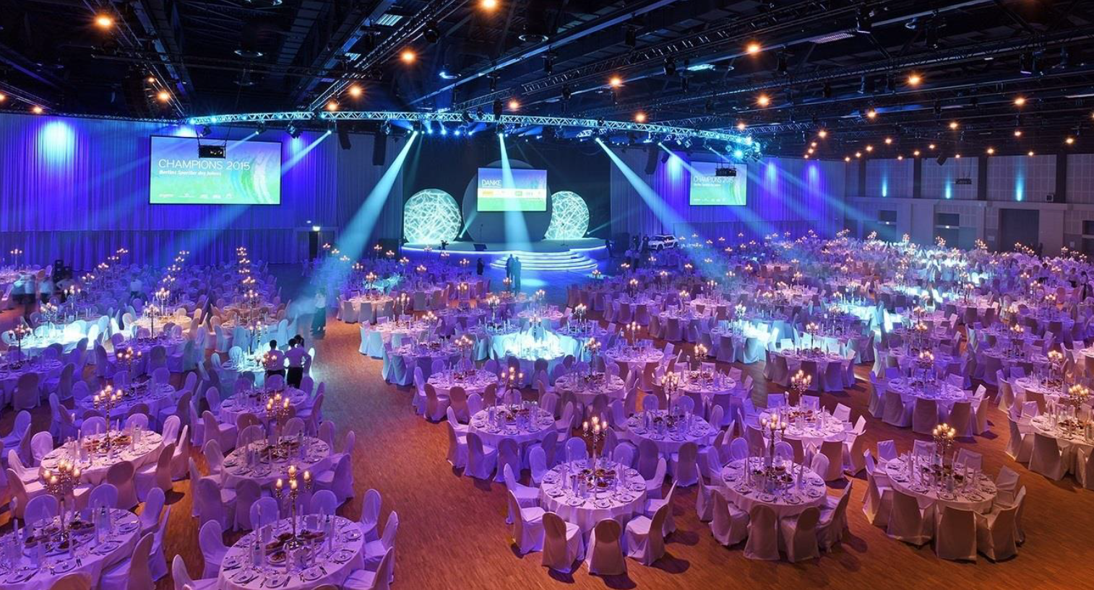
Conference Dinner, Welcome Party, Poster Party,
Science Slam
The Estrel Convention Center is able to host all these site events in-house.
The Science Slam can be organised and moderated by the Young EFC

Slide 13
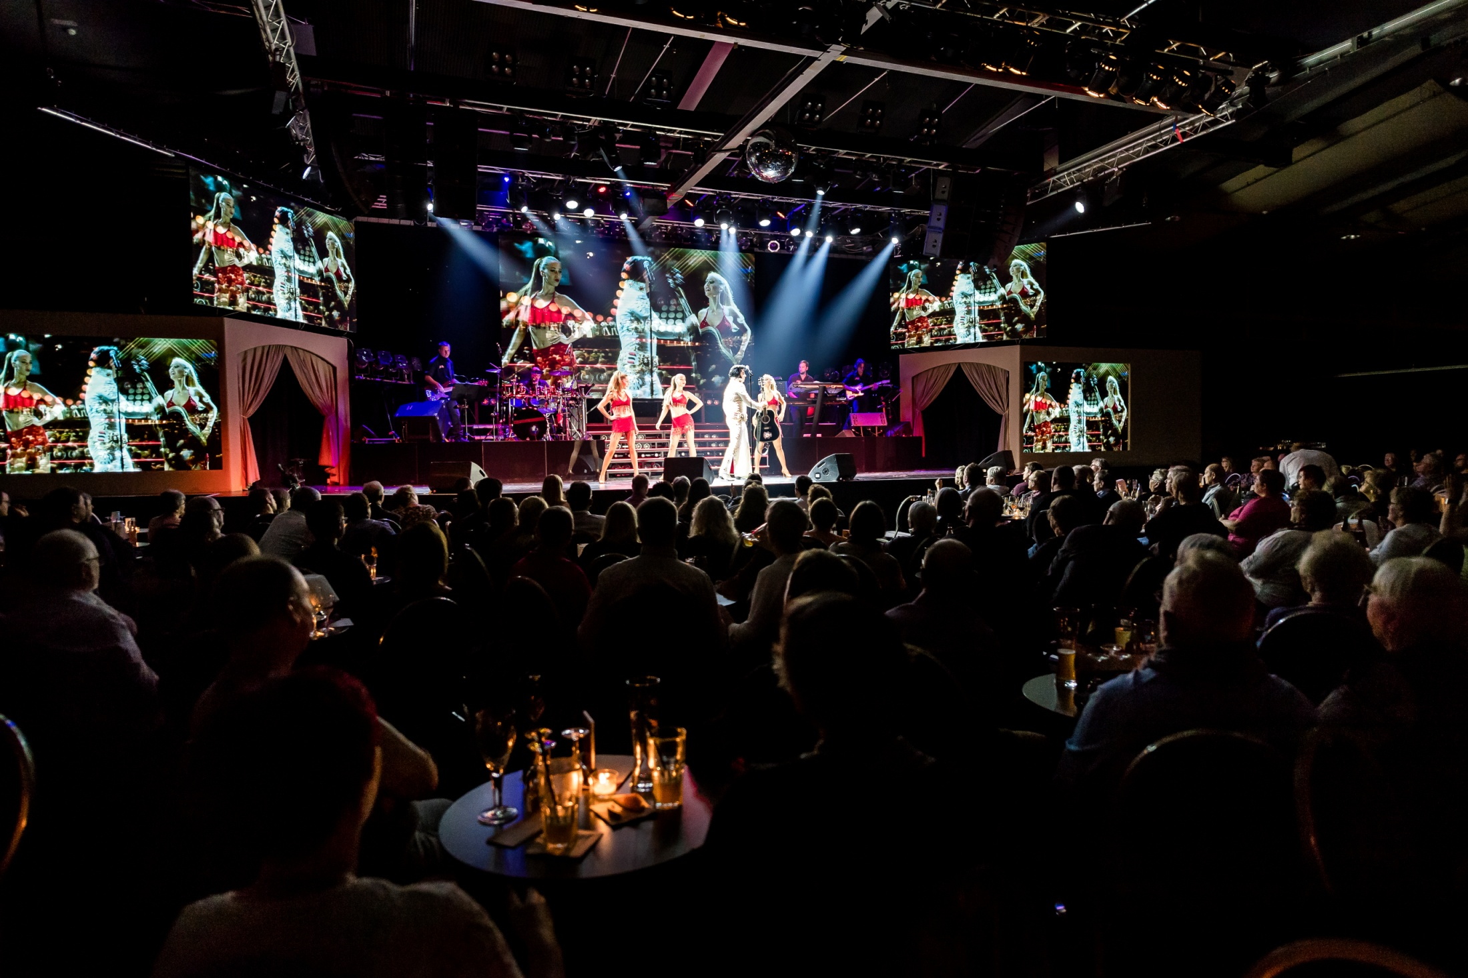
Conference Dinner – Stars in concert
at the Estrel

Slide 14
Details of EUROCORR
Expected number of participants : 1200
Participant profile (%)
Academics: 40
Industry: 40
Students: 15
Complimentary: 1
Committee: 4
Registration fee profile:
Member EFC: 780-880 €
Non-Member EFC: 890-950 €
Students: 380-430 €
Committee: free
Others (accompanying persons) 200 €

Slide 15
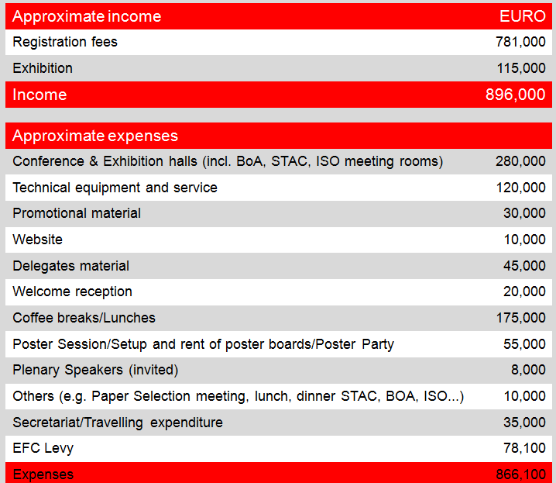
Calculation
*
*
*
*
*
*
* subject to number of participants / figures for 1000 paying participants and 45 exhibitors

Slide 16
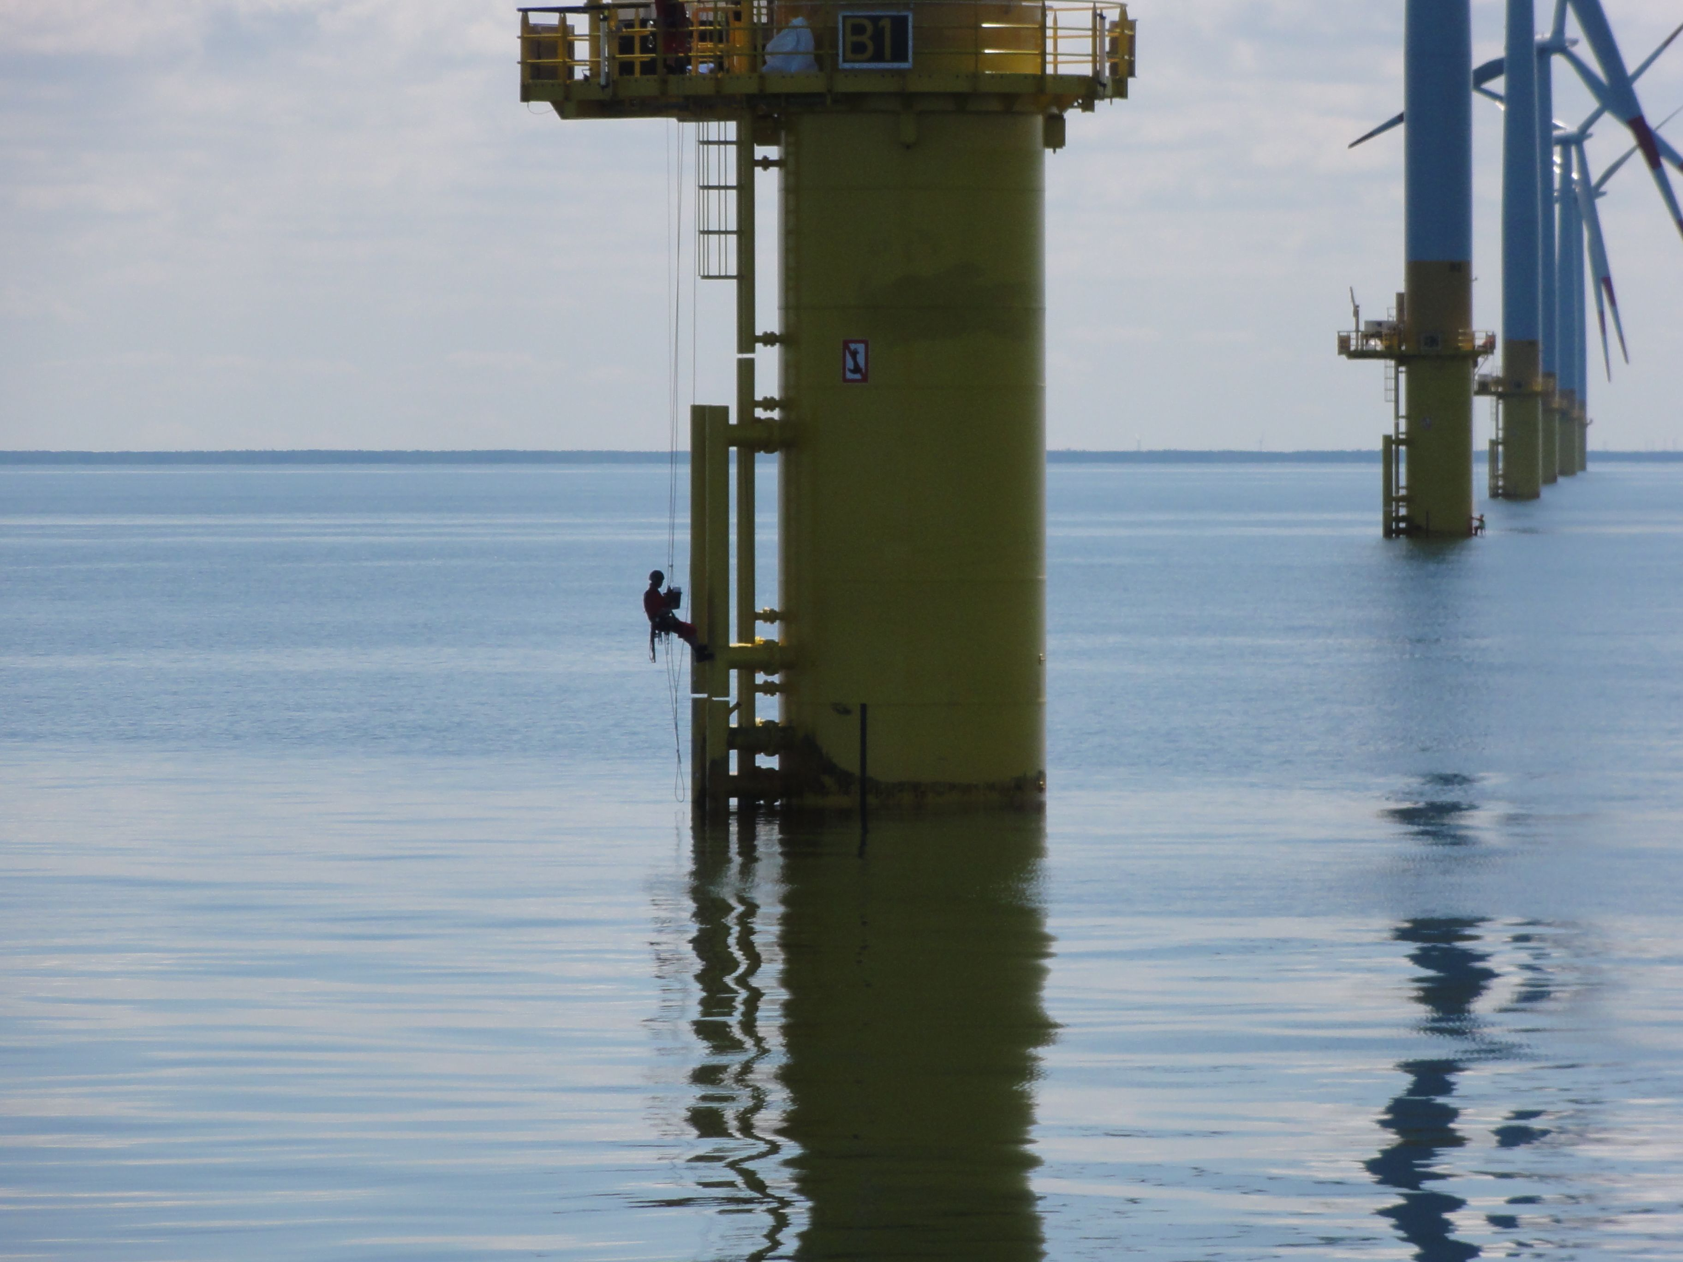
Scientific Topics
• Corrosion and protection in new energy technologies
• Simulation, modeling and life time prediction
• Protection of light weight constructions
• Corrosion of biomedical devices
• Corrosion in chemical process industries
In addition to the scientific areas covered by
the Working Parties, the following topics will
be included:

Slide 17
3. ACCOMMODATION
Hotels, Guesthouses and Hostels in Berlin
Berlin Hotel Capacities
Selection of Hotels

Slide 18
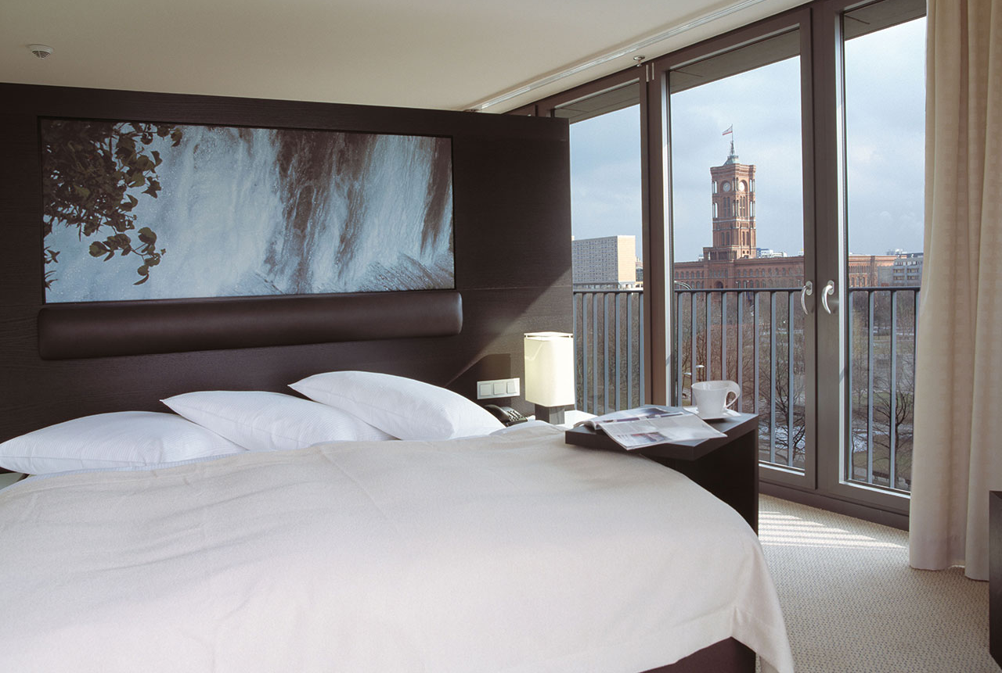
About 800 accommodation establishments
such as hotels, guesthouses and hostels in Berlin with more than 140,000 beds available

Slide 19
Berlin Hotel Capacities
CATEGORY | HOTELS | ROOMS | PRICES
***** | 44 | 18,376 | from 150 €
**** | 257 | 64,521 | from 100 €
*** | 243 | 34,625 | from 80 €
** | 57 | 9,306 | from 50 €
Unranked* | 218 | 15,927 | from 10 €
Total | 819 | 142,755
* Includes normal hotels, guesthouses and hostels

Slide 20
Ø 94 Euro per double room in Berlin (2018)
Good value for money in Berlin
Source : Hotel Price Index Trivago, Durchschnittspreis bezahlt via Trivago / Doppelzimmer /Feb 2018- Feb 2019

Slide 21
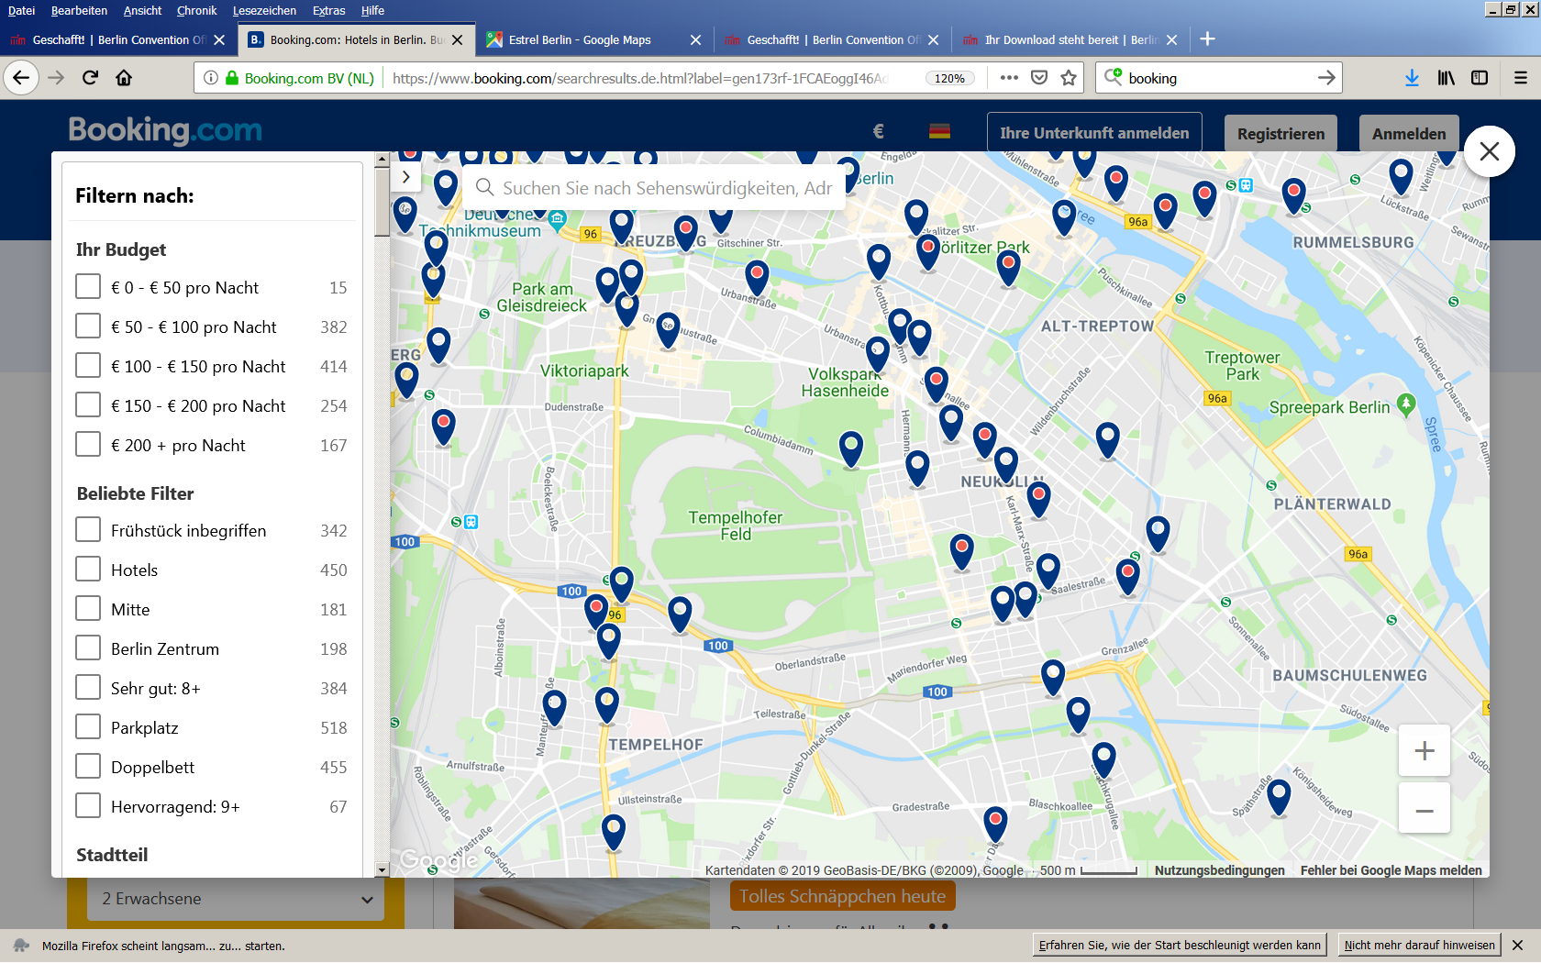
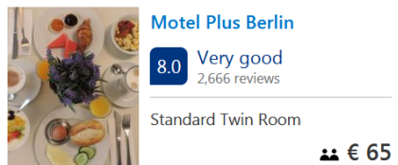

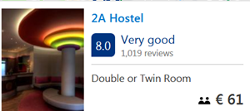
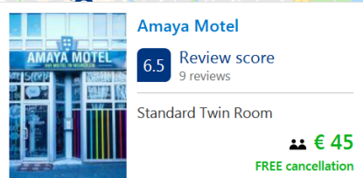
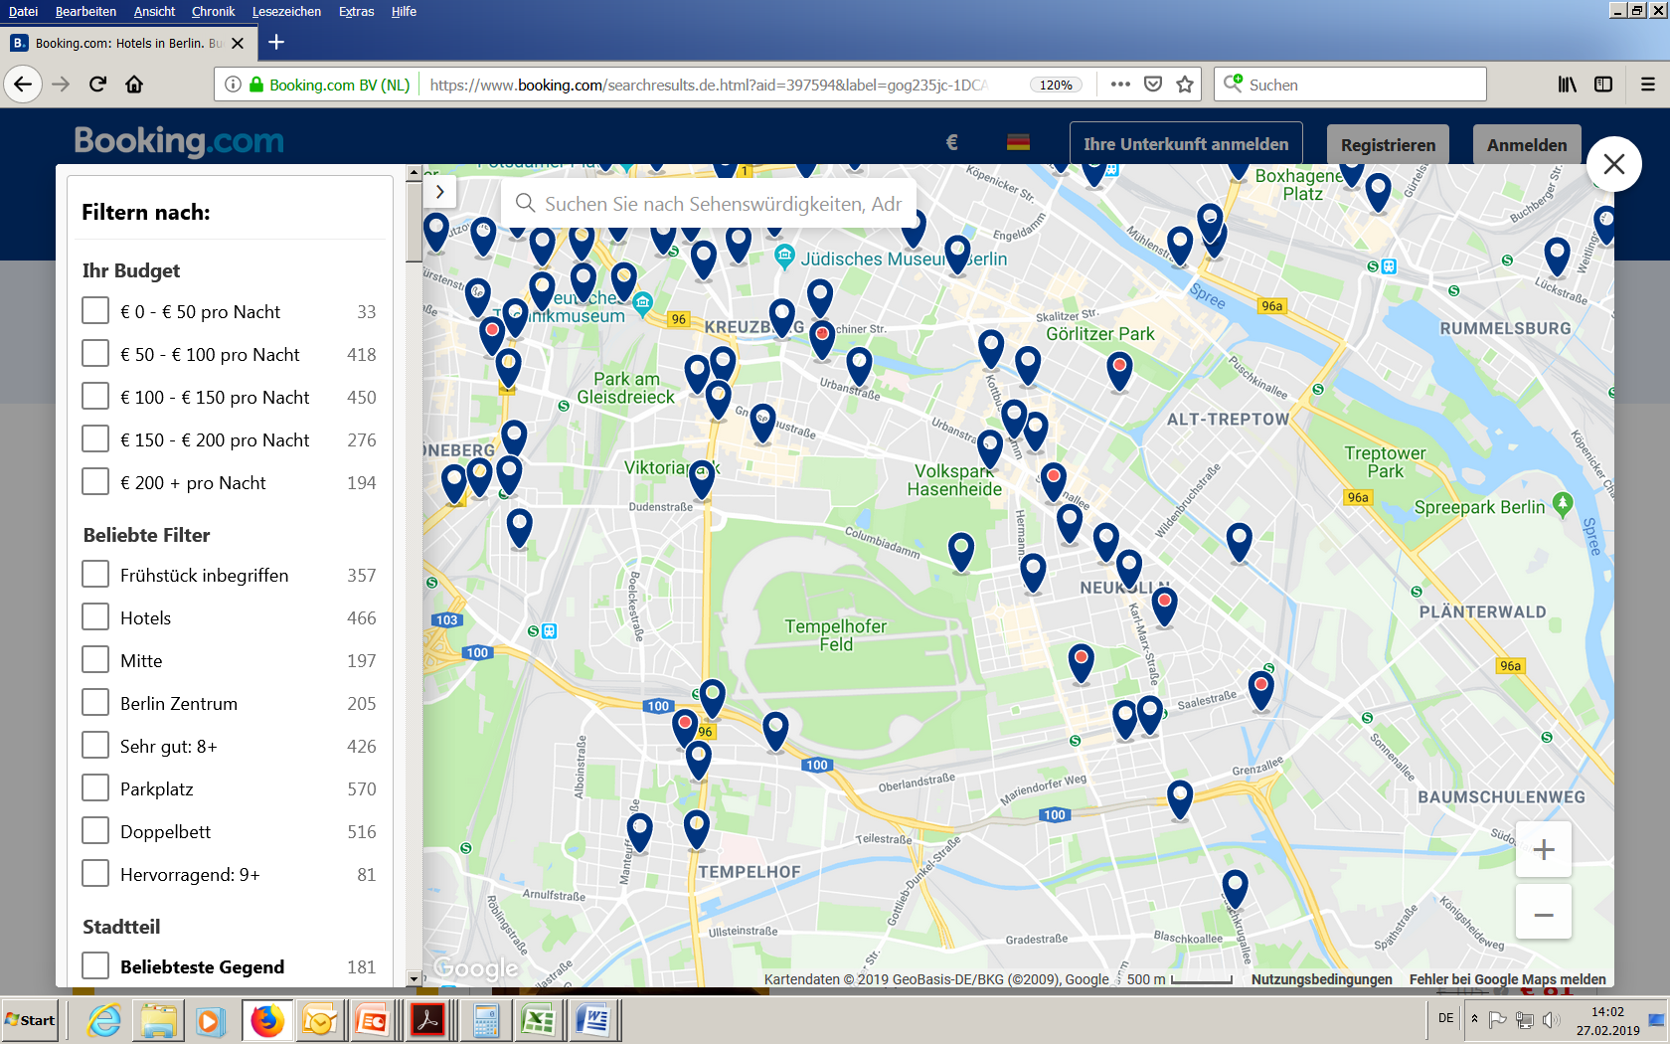
Selection of hotels
some examples of hotels
near the Conference Venue

Slide 22
4. TRAVEL AND TRANSPORTATION
Travelling by Plane
Map of Flight Destinations
Geographical Position and Arrival

Slide 23
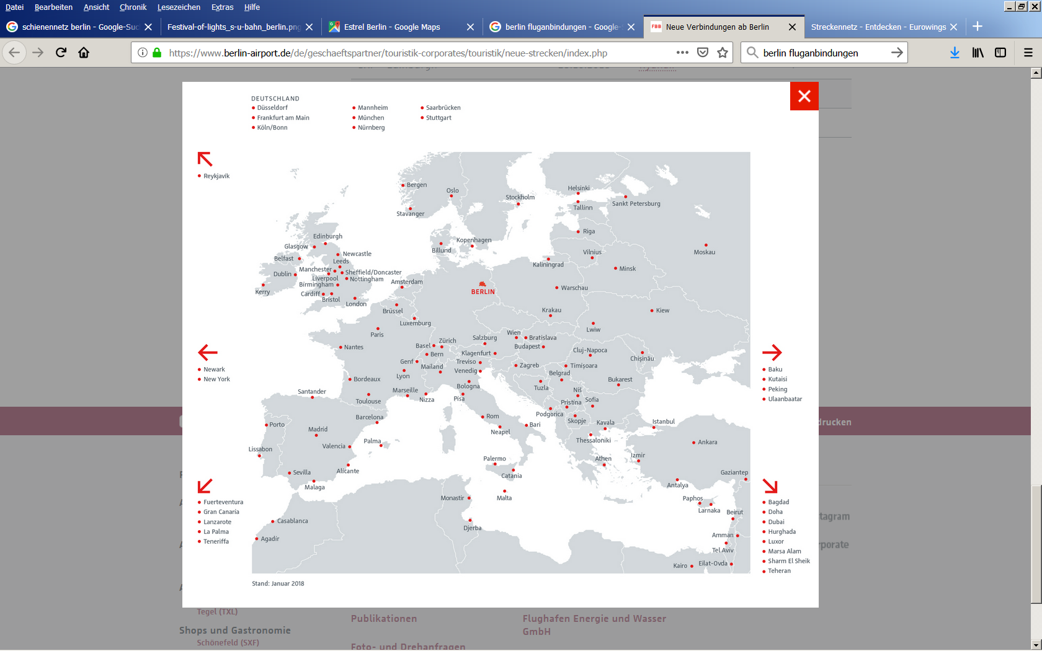
Berlin is literally in the center of Europe
Direct flights from all major European airports e.g.:
Paris (CDG) Brussels Amsterdam
Madrid Zurich Vienna
London Rome (CIA) Manchester
Travelling by Plane
Direct flights to all major German airports,
flight time less than one hour.

Slide 24
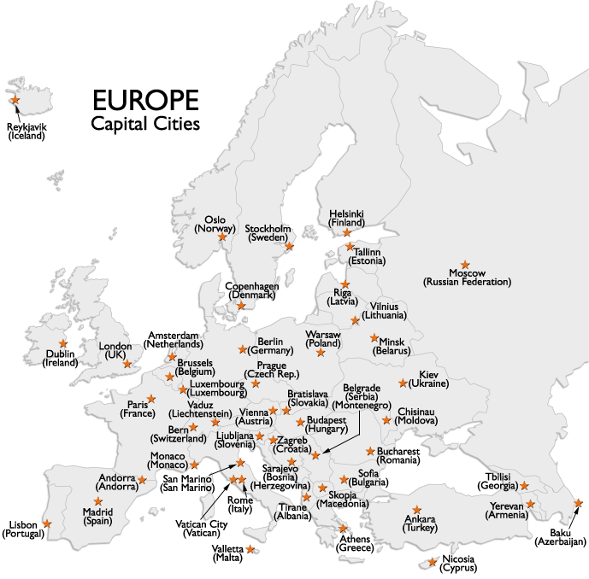
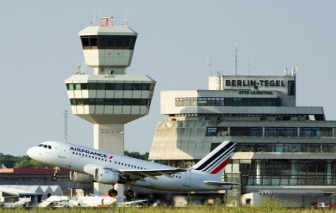
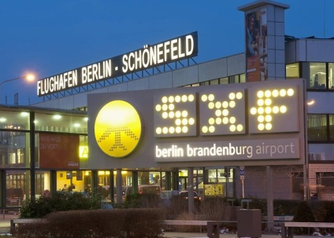

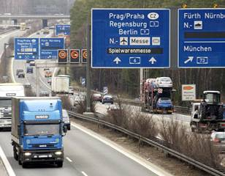

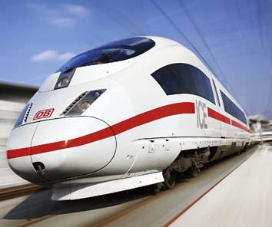

Two Airports
3rd under
Construction
3 hr
2 hr
1 hr
24 hr
10 hr
5 hr
5 hr
10 hr
High Speed Train
Connection
24 hr
Geographical Position and Arrival
Situated in the centre of Europe
Quick and easy to reach

Slide 25
5. BERLIN: THE “WOW” FACTORS…
Berlin in Brief
History & Culture / Museums
Social Program
Culinary Highlights

Slide 26
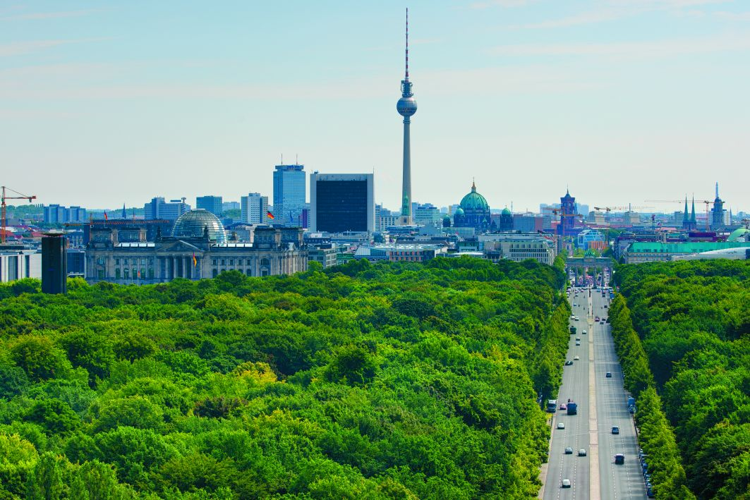
Berlin in Brief
MORE MUSEUMS THAN RAINY DAYS
7,600 STATIONS AND STOPS
LARGEST UNIVERSITY CITY
175 MUSEUMS
130 THEATRES
> 140,000 BEDS
TEN SPECIALISED COLLEGES
CAPITAL CITY
> 800 ACCOMMODATION OPTIONS
NINE TIMES LARGER THAN PARIS
THREE UNIVERSITIES
140,000 STUDENTS
FOUR ART COLLEGES
5,500 RESTAURANTS
NO “LAST CALL”
GREEN CITY

Slide 27
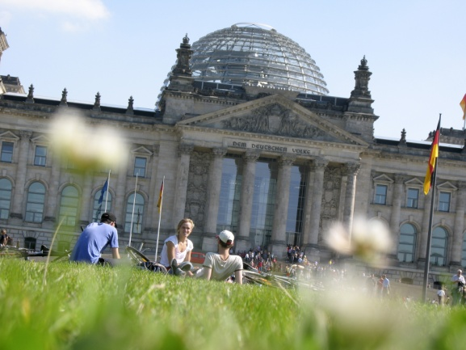
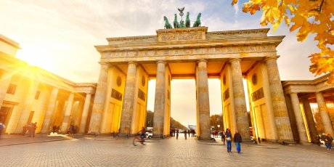
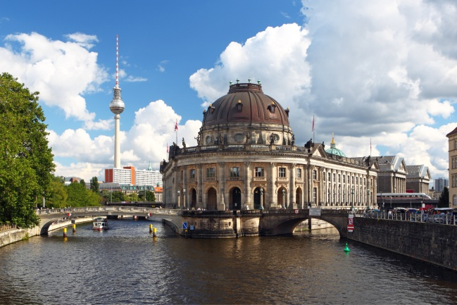
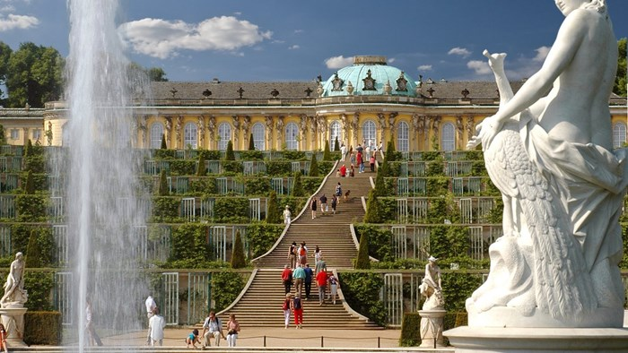
History & Culture / Museums
Reichstag, Museumsinsel,
Brandenburger Tor, Gedächtniskirche, Berlin Wall,
Castles Charlottenburg, Sanssouci, Grunewald and Bellevue
175 Museums e.g. Pergamon Museum, National Gallery, Checkpoint Charlie

Slide 28
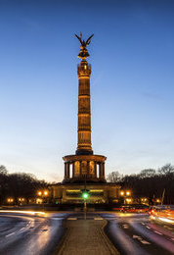
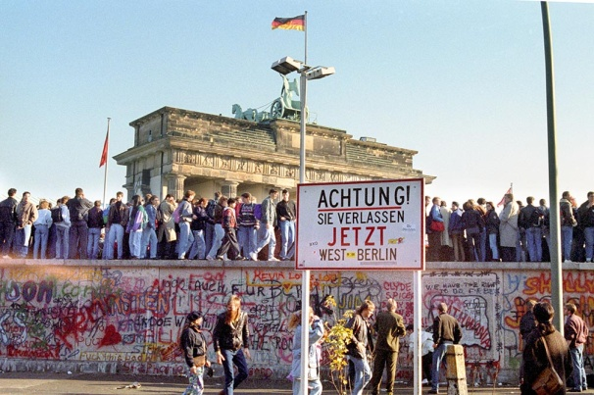

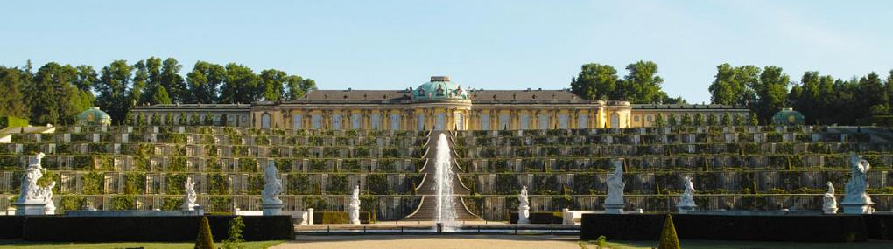
Social Program
Guided City Tours, Berlin Wall History
Potsdam-Tour, Boat trips, Day trip to Spreewald
Theatre, Concerts, Nightlife, Shopping

Slide 29
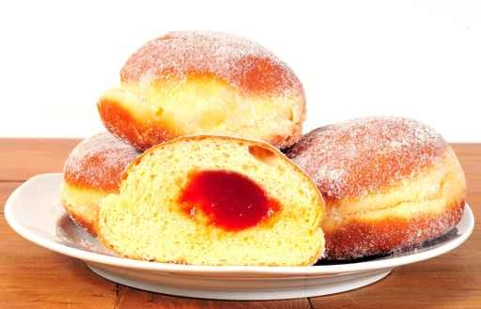
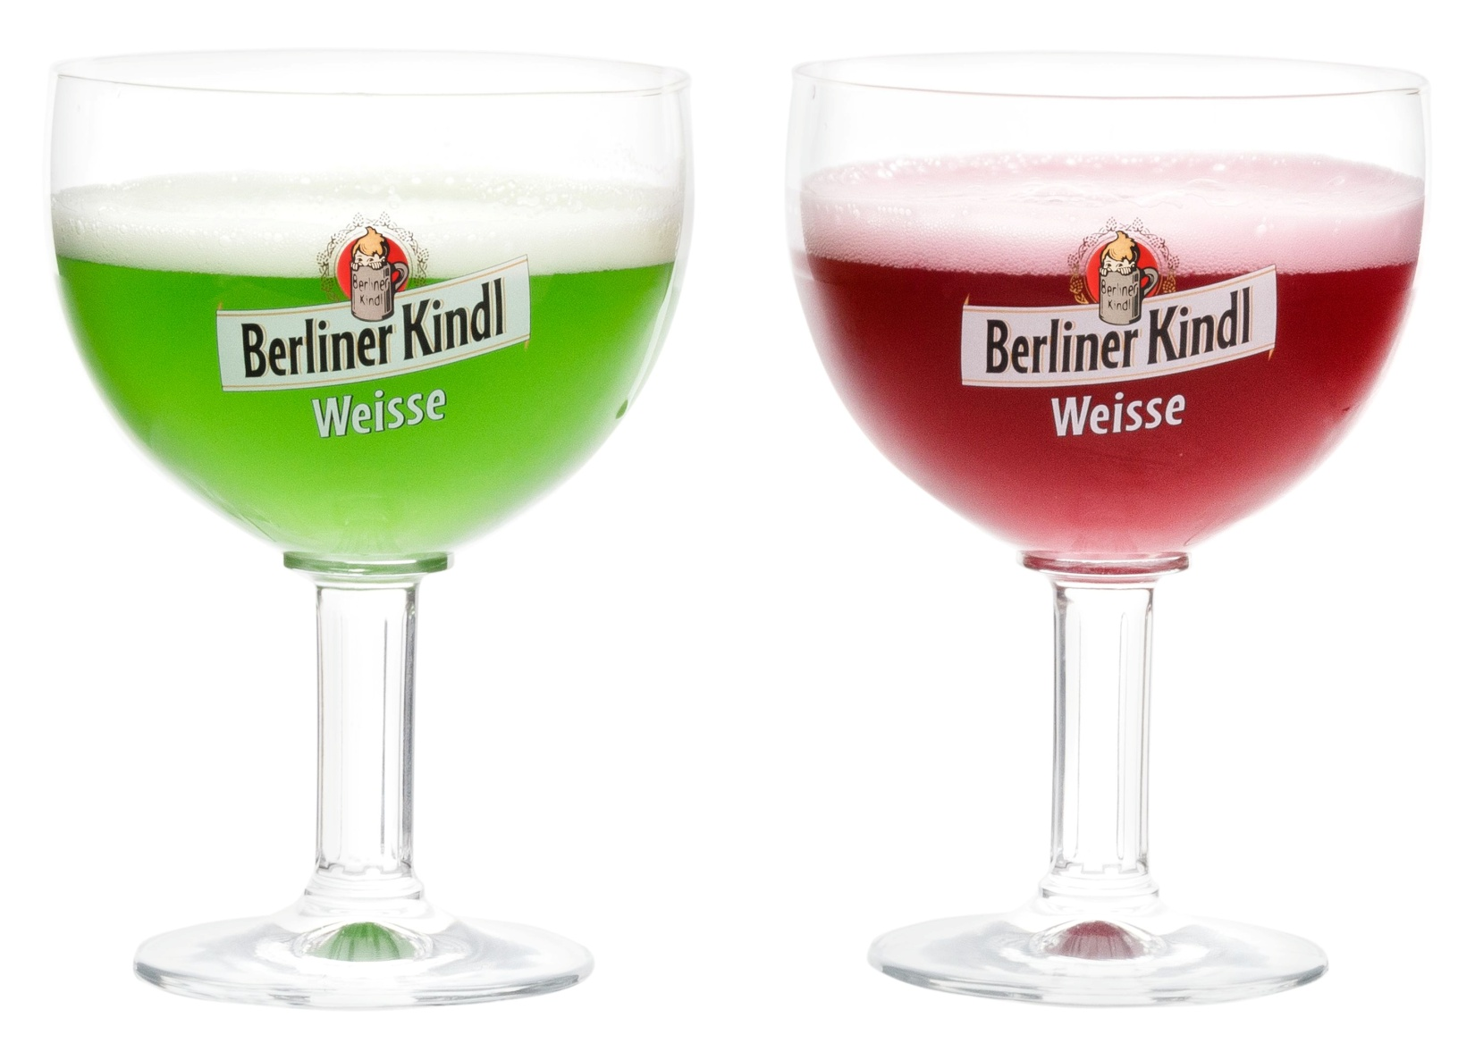
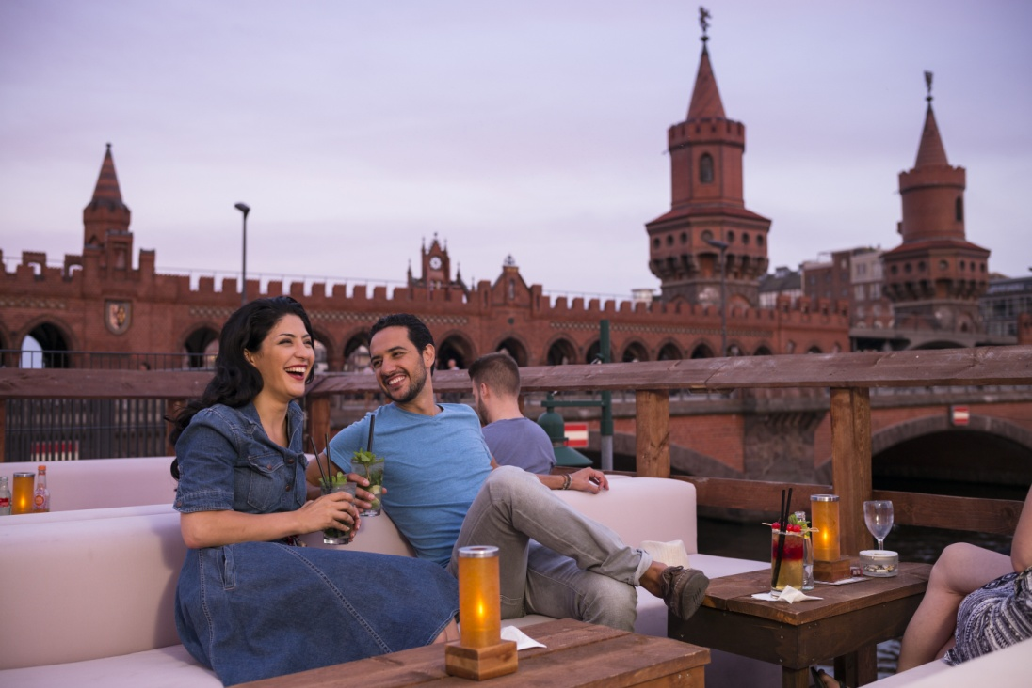
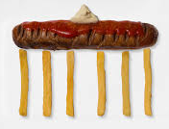
Culinary Highlights
Home of the Berliner and Curry Wurst
Only place in Germany where you get coloured beer, countless bars and typical German pubs and restaurants

Slide 30
Thank you for your attention and voting for Berlin

